Slide 1

Process Scheduler
Mr. Pranav Laxman Sadafal

Slide 2
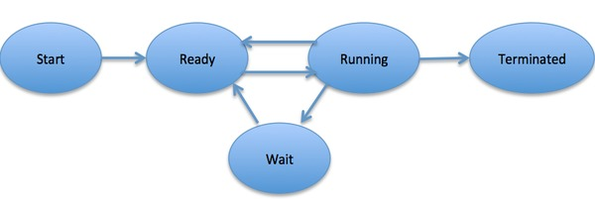
Operating System
ROM
(Hard-disk )
RAM
(Cache)
Complete
CPU

Slide 3
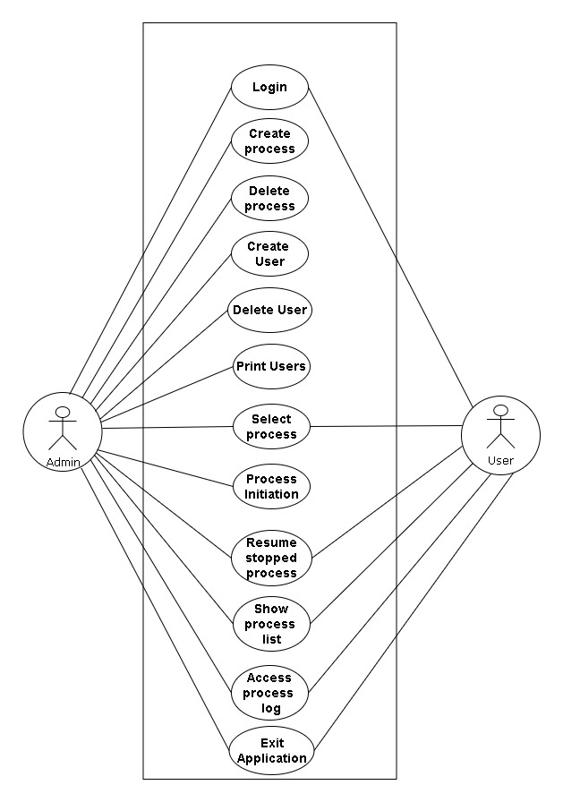
Use Case Diagram

Slide 4
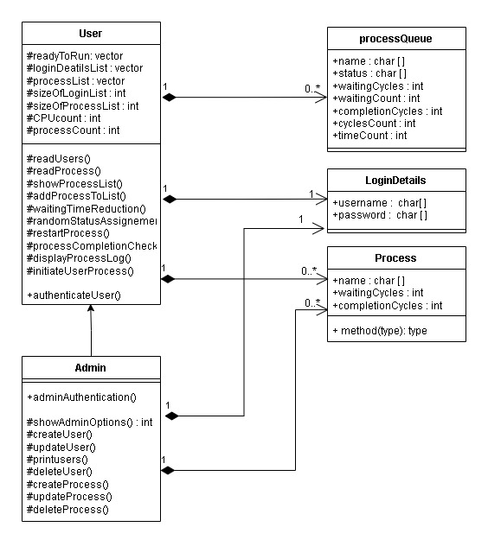
Class Diagram

Slide 5
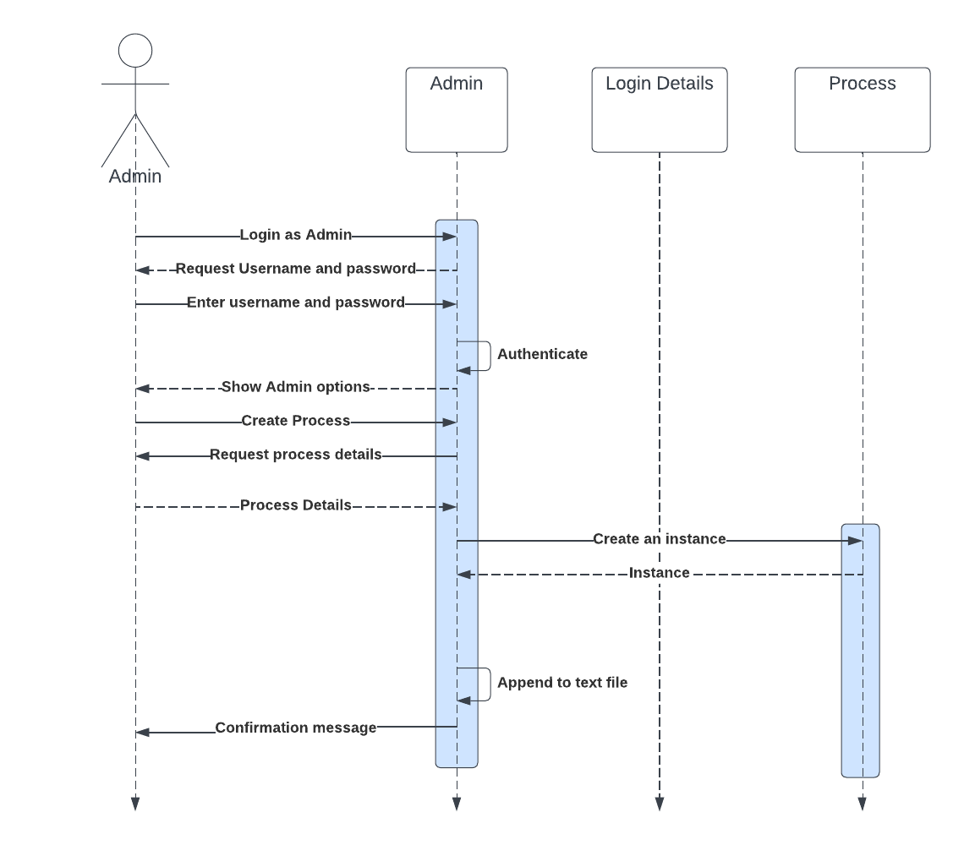
Creating a process

Slide 6
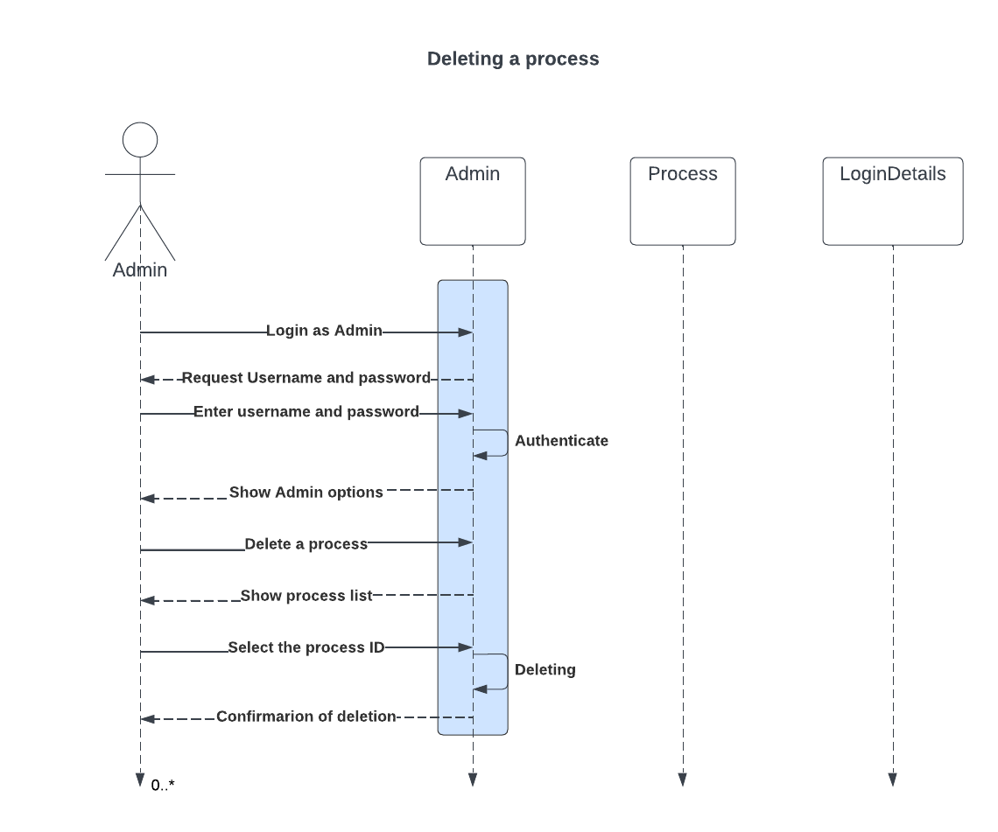
Deleting a process

Slide 7
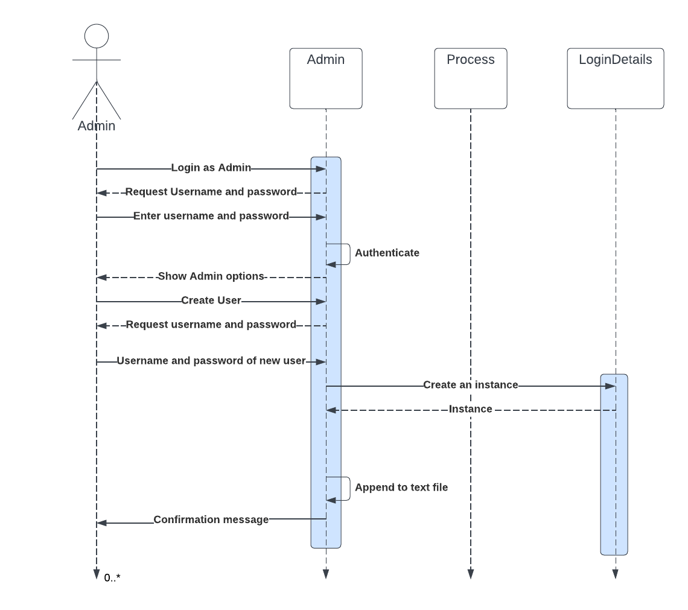
Creating a User

Slide 8
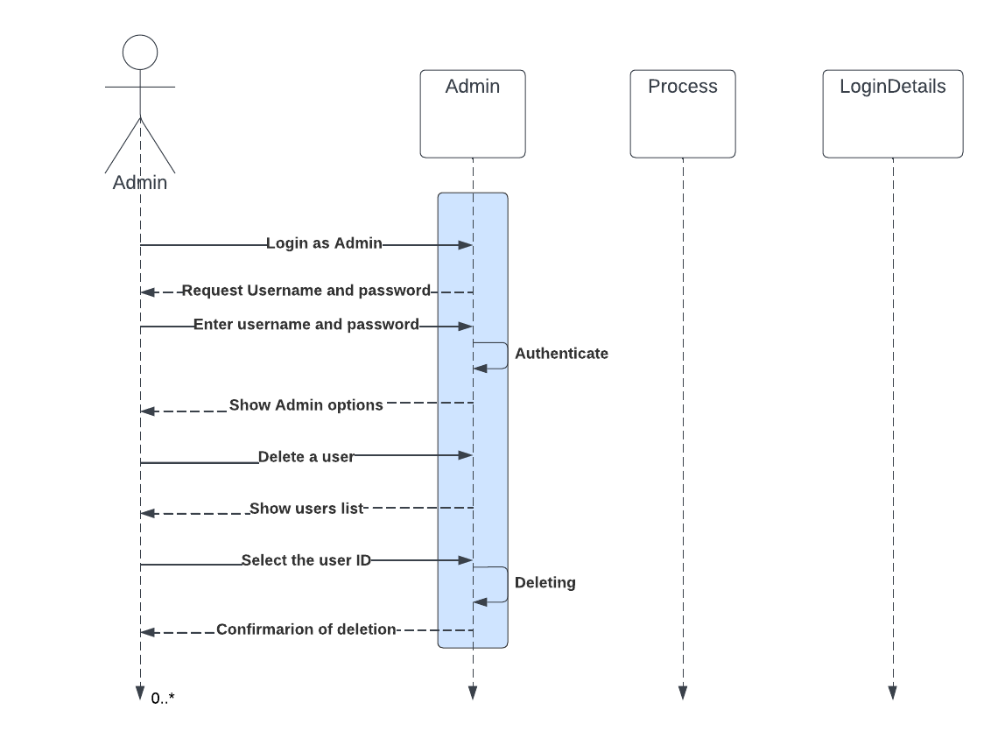
Deleting a User

Slide 9
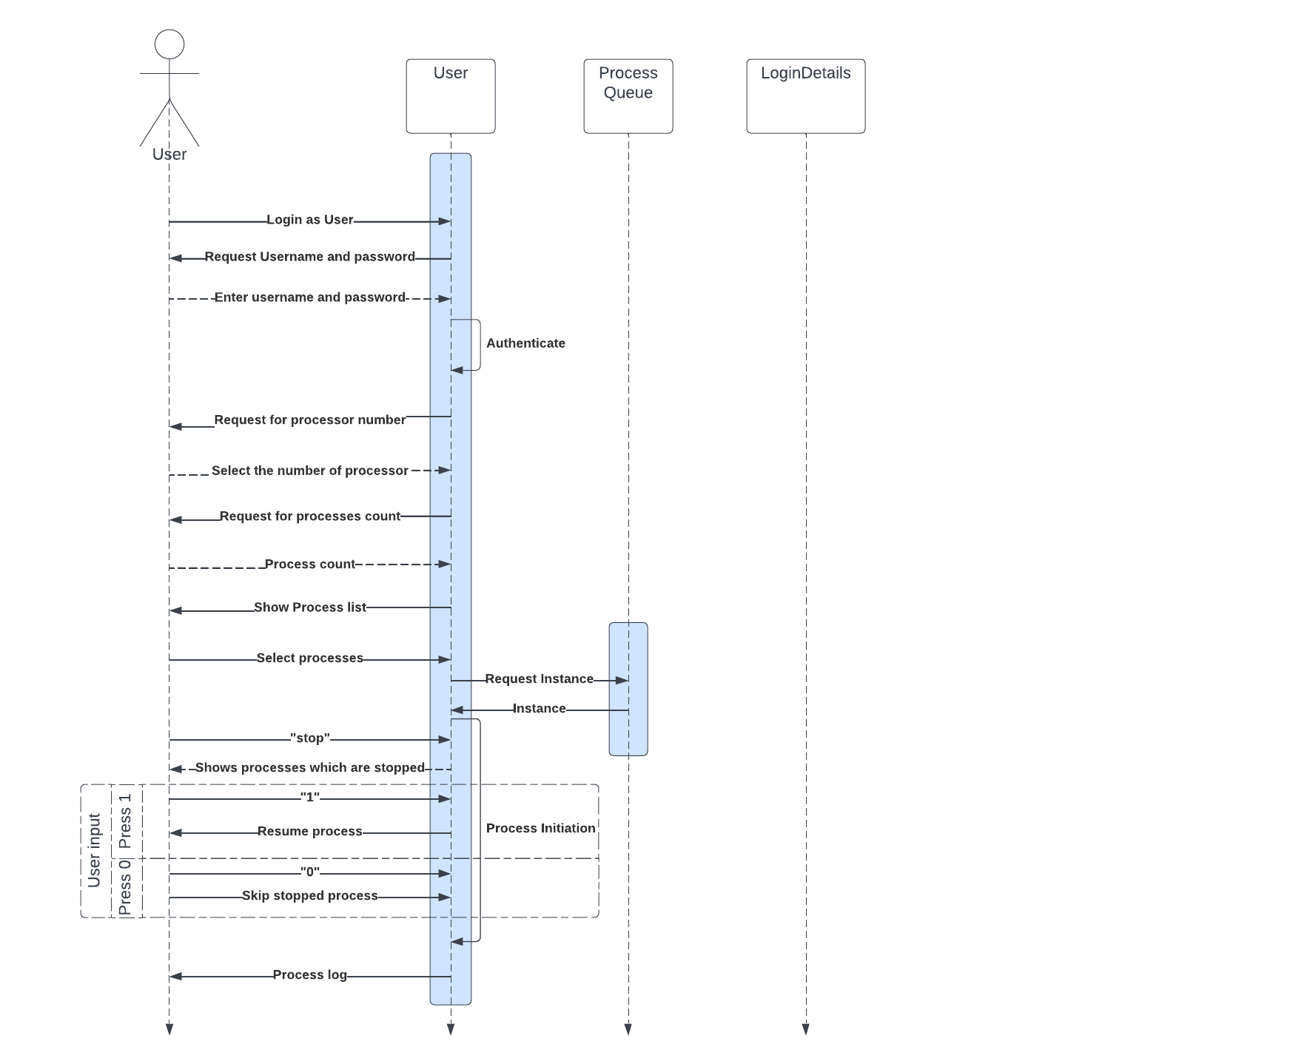
Process

